Slide 1

Bapatla Engineering College Department of Information Technology
Project Review – II
on
FOOD CALORIE ESTIMATION SYSTEM USING COMPUTER VISION AND DATA SCIENCE
Under the Esteemed Guidance
of
Dr. P. Sreedhar _{M.Tech.,,Ph.D}
Presented By,
Y.Manikanta - Y22AIT530
A.D.S.G.Hima Bindu -Y22AIT401
G.Ravi Teja -Y22AIT426

Slide 2
Contents
Domain Knowledge
System Architecture
Methodology
Algorithm Working
Partial Implementation

Slide 3
Domain Knowledge
Primary Domain:
Data Science – The project analyzes food image data and predicts calorie values using trained models and nutritional databases.
Supporting Domains:
• Artificial Intelligence (AI) – Enables automated food recognition and calorie estimation.
• Computer Vision – Extracts visual features like color, shape, and texture from images.
• Image Processing – Includes preprocessing steps such as resizing, normalization, and augmentation.
Application Area:
Healthcare & Nutrition Monitoring – Assists users in maintaining healthy dietary habits.

Slide 4
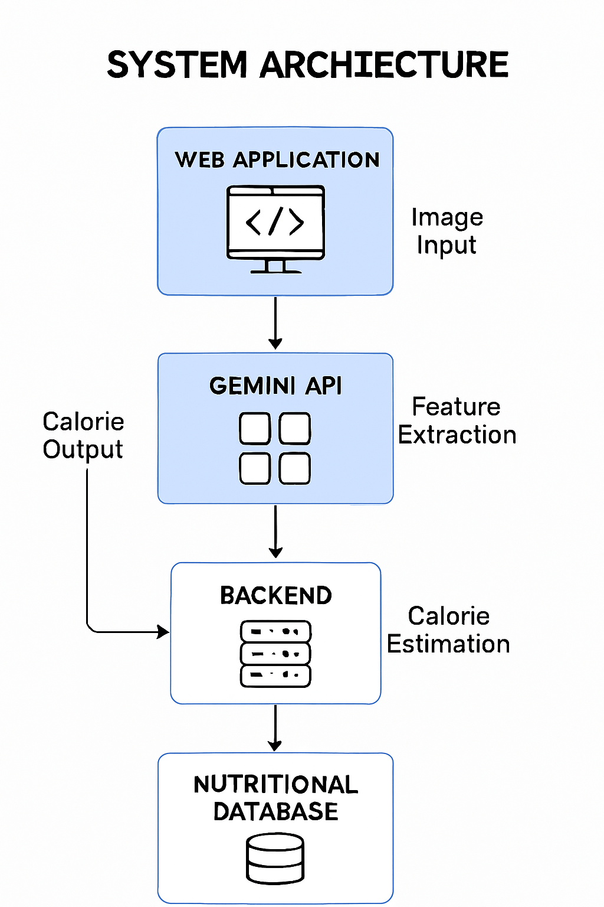
System Architecture:

Slide 5
Methodology
1.Image Acquisition:User captures or uploads a food image using the application.
2.ImagePreprocessing: Resizing to fixed dimensions. Normalization of pixel values. Data augmentation (rotation, flipping, brightness adjustment).This improves model robustness under different lighting and angles.
3.Gemini Vision Model Innovation:
Gemini 2.0 flash or Gemini pro vision is called via Open API.
The model analyzes the image and returns structured insights.
4. Food Classification : The trained deep learning model classifies the image into a specific food category

Slide 6
Methodology
5.Nutritional Database Mapping : The predicted food category is mapped to a nutritional database containing calorie values of various food items.
6. Portion Estimation : The system estimates portion size to improve calorie accuracy.
7. Calorie Calculation : Total calorie value is computed based on food type and portion size.
8. Result Display : The final estimated calorie value is displayed through a user-friendly interface

Slide 7
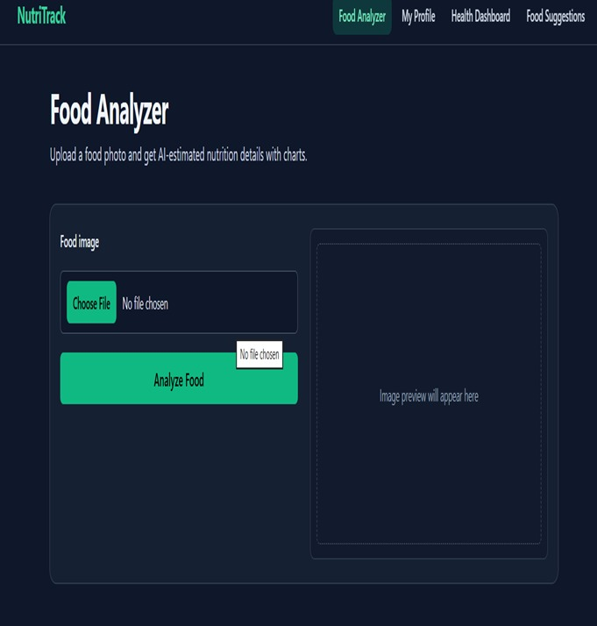
Partial Implementation

Slide 8
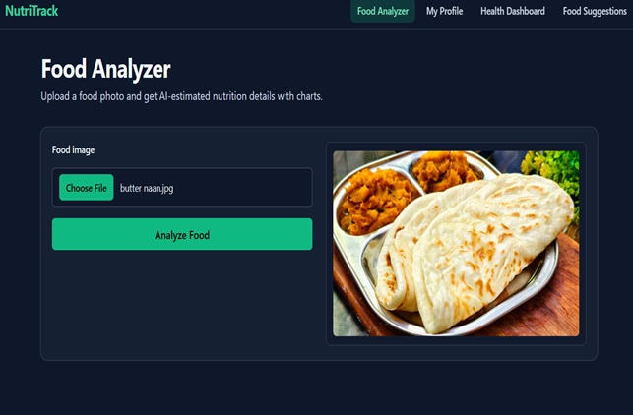

Slide 9
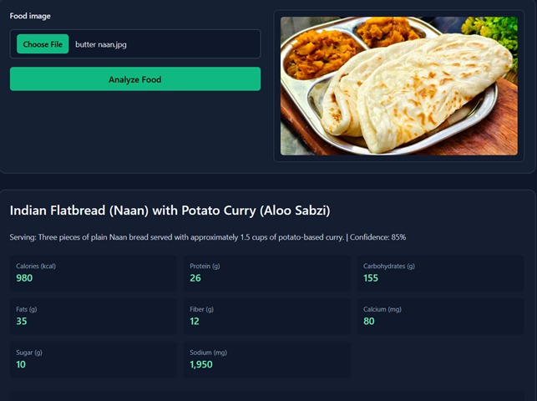

Slide 10
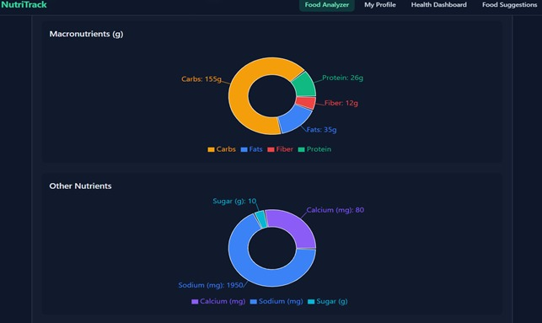

Slide 11
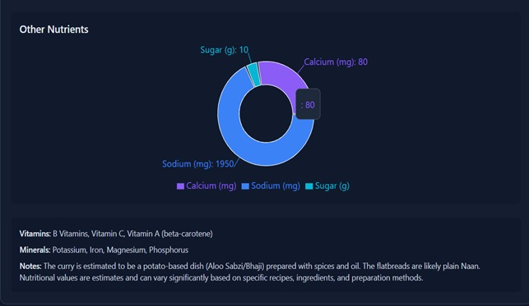

Slide 12
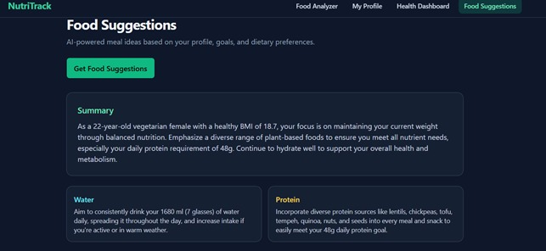

Slide 13


Slide 14


